Slide 1
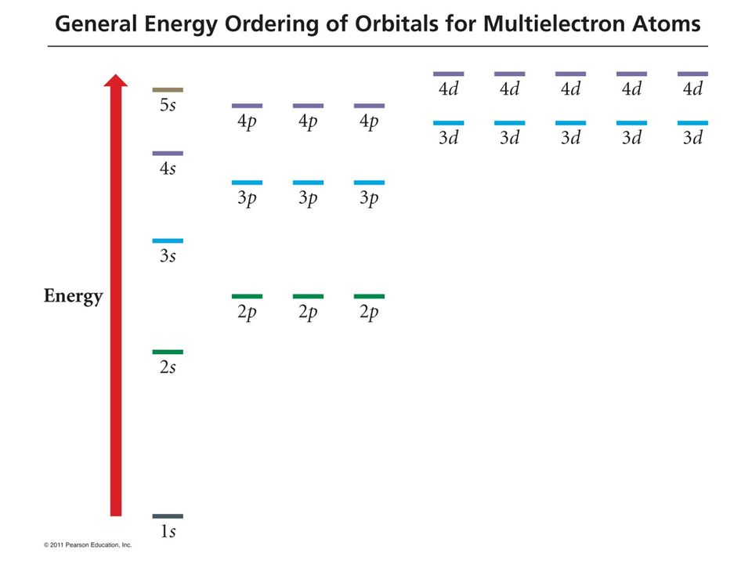
Helium: $\left[He\right]=1s^{2}$
Spartan labels this HOMO

Slide 2
Helium: $\left[He\right]=1s^{2}$
Spartan labels this HOMO – which stands for “Highest Occupied Molecular Orbital”

Slide 3
Helium: $\left[He\right]=1s^{2}$
Spartan labels this LUMO
Spartan labels this HOMO – which stands for “Highest Occupied Molecular Orbital”

Slide 4
Helium: $\left[He\right]=1s^{2}$
Spartan labels this LUMO – which stands for “Lowest Unoccupied Molecular Orbital” (next one up from HOMO)
Spartan labels this HOMO – which stands for “Highest Occupied Molecular Orbital”

Slide 5
Visualizing atomic Orbitals using Spartan
You can submit calculations for most atoms specifying Equilibrium Geometry, which is the default, and B3LYP 6-311+G** (if you specify Energy it’s a little faster). When the calculation is finished, select the Orbital Energies icon, click on one of the horizontal lines on the left side of the page, and switch to mesh style. Also, specify the ball-and-wire model.
The GEOO diagram is usually consistent with Spartan, but not always! And Spartan usually limits the orbitals it shows to a subset (outermost, valence shell).

Slide 6
Neon: $\left[He\right]$2s²2p⁶ (same as $1s^{2}$2s²2p⁶)
HOMO
Spartan doesn’t even display this (core) orbital

Slide 7
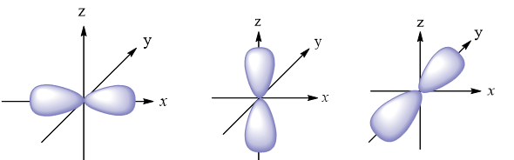
Neon: $\left[He\right]$2s²2p⁶ (same as $1s^{2}$2s²2p⁶)
HOMO
Spartan doesn’t even display this (core) orbital

Slide 8
Neon: $\left[He\right]$2s²2p⁶ (same as $1s^{2}$2s²2p⁶)
HOMO
But our GEO diagram got the LUMO wrong … can you tell how?
Spartan doesn’t even display this (core) orbital

Slide 9
Neon: $\left[He\right]$2s²2p⁶ (same as $1s^{2}$2s²2p⁶)
GEOO says this is the LUMO
HOMO
Spartan doesn’t even display this (core) orbital

Slide 10
Neon: $\left[He\right]$2s²2p⁶ (same as $1s^{2}$2s²2p⁶)
But Spartan says this is the LUMO
HOMO
Spartan doesn’t even display this (core) orbital

Slide 11
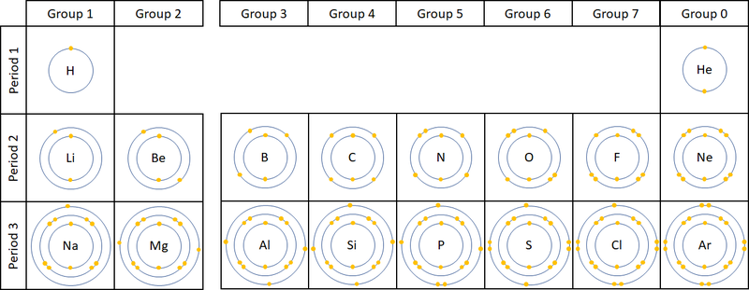
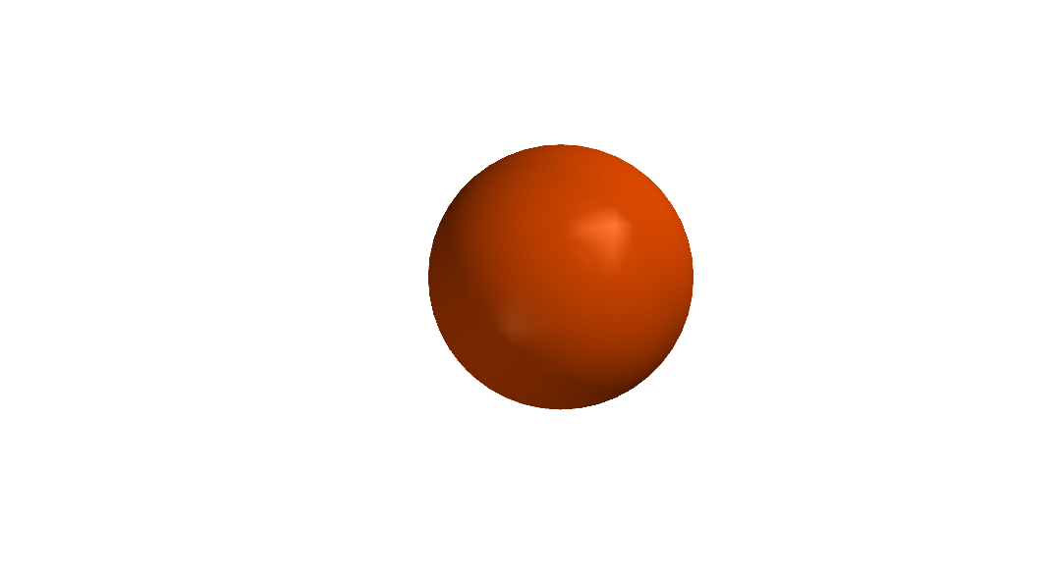
Remember we said that the size of atoms is determined by the electrons?
… magically become spherical (this is Spartan’s space-filling depiction)
All piled on top of each another …

Slide 12
Remember we said that the size of atoms is determined by the electrons?
… magically become spherical (this is Spartan’s space-filling depiction)
All piled on top of each another …
Higher-numbered shells are bigger because their orbitals are bigger

Slide 13
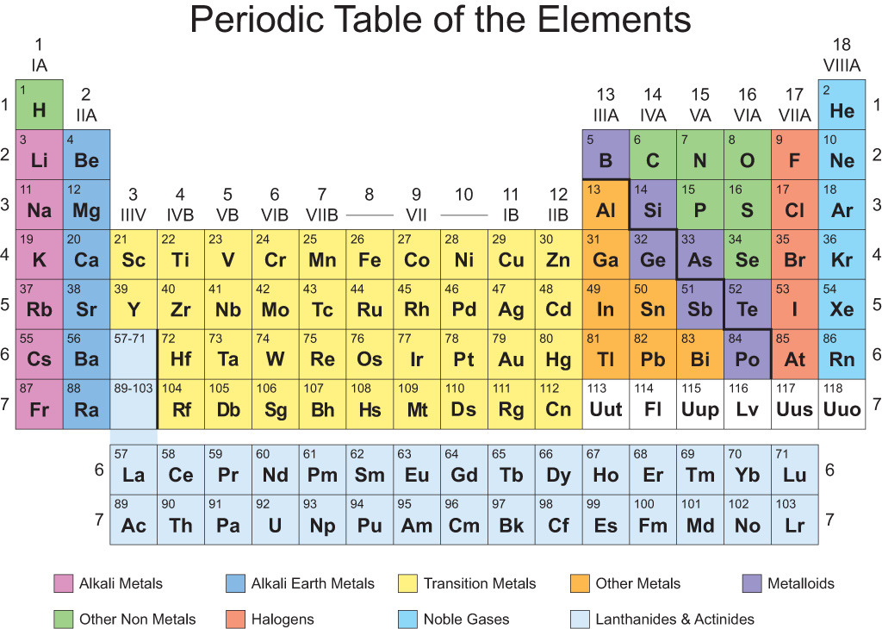
4s
[K] = [Ar] 4s¹
[Ca] = [Ar] 4s²

Slide 14
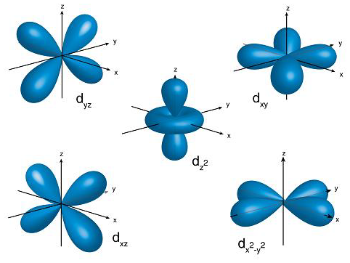
3d
Did you see these in Spartan? How were they similar/ different?
[Sc] = [Ar] 4s²3d¹
…
[Zn] = [Ar] 4s²3d¹⁰

Slide 15
4p is next
[Ga] = [Ar] 4s²3d¹⁰4p¹

Slide 16
4p is next
[Ga] = [Ar] 4s²3d¹⁰4p¹
[Ge] = [Ar] 4s²3d¹⁰4p²
…
[Kr] = [Ar] 4s²3d¹⁰4p⁶

Slide 17
Noble gases He through Kr
[He] = 1s²
[Ne] = [He] 2s² 2p⁶
[Ar] = [Ne] 3s² 3p⁶
[Kr] = [Ar] 3d¹⁰ 4s²4p⁶
[Xe] = … 5s² 5p⁶
[Rn] = … 6s² 6p⁶
All are filled through their p-subshell; all are inert (non-reactive) gases. The Noble Gases

